Slide 1

Scaling to $100MM! Lessons from 150 successful founders
Imran Sayeed
MIT Sloan School of Management
isayeed@mit.edu

Slide 2
Impetus for our research
How many companies founded in the last 10 years reached $100MM ARR
$10MM ARR
Why does it matter ?
Have an industry-wide impact
Help develop the entrepreneurial ecosystem in the region (Angels, Next gen entrepreneurs, M&A, role models etc)
Why did we develop a new course on this topic ?
Lots of courses focused on early stage, none on growth to $100MM+
Strong need expressed by students and alums with existing or previous startups
Limited academic research on challenges of growth to $100MM+ and successful approaches
Notes:
0.7% reach 100MM ARR, 13% reach 10MM ARR

Slide 3
Our Approach
Instructors’ experience
Surveyed 150 MIT Alums who had created unicorns
Diversity of industries: Blackrock, Hubspot, Moderna, Zipcar, Curriculum Associates, Clabs
Diversity of old vs new companies: Lotus 123, 3Com, Analog Devices, DropBox, Moderna, Bitsight
Diversity of company size: $100MM-$5B+
Diversity of Age of Founders: 21-50+
Gender diversity: 17% female
Primarily US based
Invited 1 successful entrepreneur to class to discuss each of the top 10 obstacles
Strong confidentiality clause
1 page writeup beforehand
In depth discussions with the students and professors

Slide 4
Some Observations from the Survey
Top 3 obstacles ?

Slide 5
Founding Years
Top Obstacles
Product-market Fit (2x)
Finding co-founder and initial team
Fundraising

Slide 6
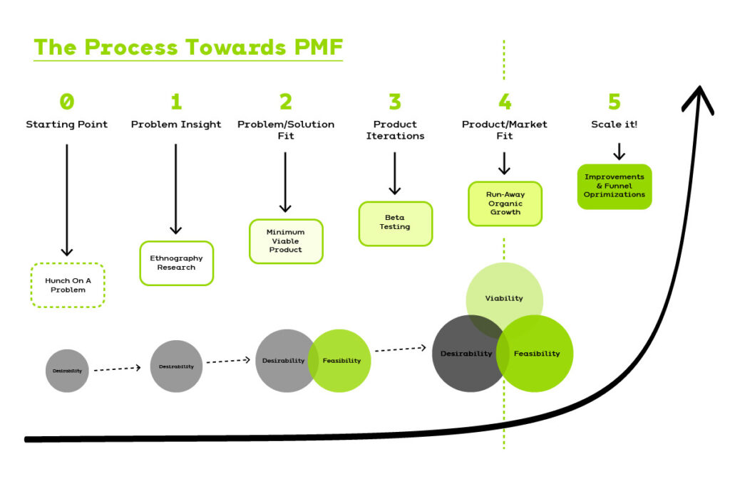
What is Product Market Fit
It means you have significant, sustained demand for your product

Slide 7
Signs & Metrics of PMF
High growth rate
Product shows high levels of user engagement and conversion
Sales cycles are fast
Customer Retention Rate >50%
CLV/CAC >3
NPS > 70
Sean Ellis Metric > 40%

Slide 8
Product Market Fit: Common PMF obstacles that inhibit scaling
Skipping the PMF process because of services customers or in-house customers
Assuming that finding early adopters = achieving PMF
Premature Scaling
Not evolving PMF as the company scales

Slide 9
Founding Years: Founding Teams That Scale
Teams NOT individuals
Characteristics of successful founders
Over-achievers, passionate
Tenacious
Willing to have co-founders who have diverse backgrounds
Listen to diverse view-points and synthesize into actionable plans
Learn from failures
Age of successful founders ?
Age is less important than experience as an entrepreneur
Mix of corporate & startups members across the LT and the entire organization
Biggest challenge for corporate spinoffs is “un-learning” big company culture and processes
Hire a good lawyer and put everything in writing

Slide 10
Founding Years: Fundraising and VCs: Optimize for partners not valuation
Great investors and the entrepreneurs they back should feel like they’re part of the same team
Great investors realize they’re not making strategic decisions, it’s the team’s decision, and they’re either backing them or not
Investors have helped with
Brand & Marketing
Key hires
Partnerships, M&A
Bad investors have hindered
Growth (not allowing investments by board, replacing founders)
Profitability (growing too fast)
A company’s ability to reach its full potential

Slide 11
Founding Years: Fundraising & VCs: Tips for first time CEOs
Don’t be intimidated by high-powered VCs on your Board. YOU are still in charge!
Not everything the VCs say is gospel. YOU still know your business best!
Put pressure on the VCs to deliver on their promises to you!
Forming the Board
Need a credible supporter on the Board.
Beware of investor(s) goals/likely priorities before accepting funding and certainly before admitting her/him to the Board.
Not all co-founders need to be on the Board.
Retain capable, trustworthy lawyer and be sure that they attend all Board meetings.
Managing the Board:
Hold regularly scheduled Board meetings
Personally call every Board member ~one week before every meeting to synopsize the agenda contents, especially to discuss any anticipated issues.
Listen carefully to all Board members and respect that their opinions are at least worthy of consideration

Slide 12
Market Entry & Early Growth
Top Obstacles
GTM Challenges (2x)
Managing Early growth
Pivoting

Slide 13
Common GTM challenges that inhibit scaling
“If it ain’t broke, don’t fix it” mentality
Setting up partnerships the right way
Hiring the right sales leaders and creating the right sales process
Pricing changes

Slide 14
Ineffective Execution
Often the founder/CEO can be the cause of this
Doesn’t delegate decision making
Changes directions too often
Doesn’t follow process
Hiring too many “big company” execs can also slow down execution with hierarchies, endless meetings and rigidity
Culture really starts to pay dividends at this stage

Slide 15
Growth to $100MM+
Top Obstacles
Managing late stage growth (2x)
Pivoting
Board Dynamics

Slide 16
Growth to 100MM+: GTM Challenges
Incumbents playbook: Copy, Bundle, Kill! – how to counter that
Creating a scalable GTM engine and managing CAC
Expanding product line and increasing price -> Increased ARPA
Moving from Product to Platform ?

Slide 17
All Stages: Hiring/Growing/Replacing
Types of people to hire: A-players
Ability
Aptitude
Attitude
How do you attract them to your startup ?
Well articulated and compelling vision - Mission-driven is even better
Hire for potential
Prominent investors or board members can help
Only give equity to those who value it
Tips for hiring and developing people
Retired Sr execs in a part time role can be great coaches for leadership team
Meet top leaders at other companies to establish a baseline for key roles
Tips for replacing people
Provide step back opportunities esp for technical people
VCs and Board members can help esp with co-founders
I’m super qualified for my job – 2 years ago!

Slide 18
All Stages: Be prepared to pivot
Need to be done for the right reason
Often harder than a new startup
Needs incredible support from investors
Needs a strong leader to execute

Slide 19
All Stages: Culture is the operating system of the company
More than just a placard or something you take a CBT course on!
Have to make it REAL
Strategic decisions
New hires
Existing team
Leaders
Organization and Governance
Some winning cultural characteristics found in sustainable unicorns
Sense of urgency
Customer centricity
Creative problem solving
Accountability at every level
Rollup your sleeves attitude
Collaborative/team-oriented
Culture also changes as you grow
Challenge is to keep the best parts while adding more structure and process

Slide 20

Christina Qi
Domeyard, LP
Founding and Fundraising
As a 22-year old about to graduate from MIT, how does one go about starting a hedge fund? What credentials and how much money do you need?
How do you answer this VC question: Who do you guys think you are, to be trying to do something that so many other older and more experienced teams have failed at?
Resilience, determination, and ultimately luck favoring you if you overcome the fear of rejection
Gender/age/race biases always exist but a professional attitude and striking a balance between being nice and authoritative help
Courage, networking, community support, and a supportive professional network are keys to success

Slide 21
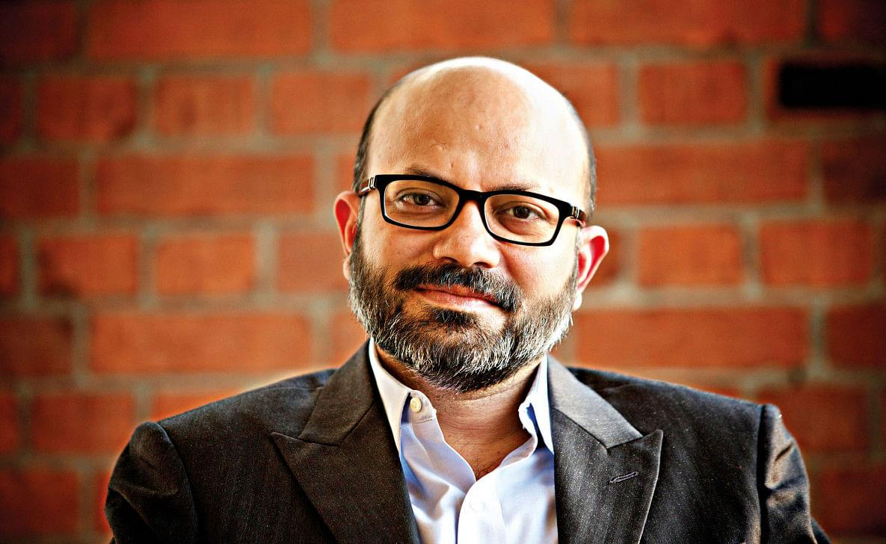
Kamal Quadir
bKash
Partners
bKash needed Telco support to offer financial services but the Telcos themselves want to offer those services.
Even if bKash partnered with a Telco, how can it ensure the quality of service?
How could balance of power settle between big and small companies?
Bridge cultural gaps between a startup and a partner
Find “gate openers” rather than “gatekeepers”
Giving a significant part of your company to get your dream closer to reality
Power is always exercised

Slide 22
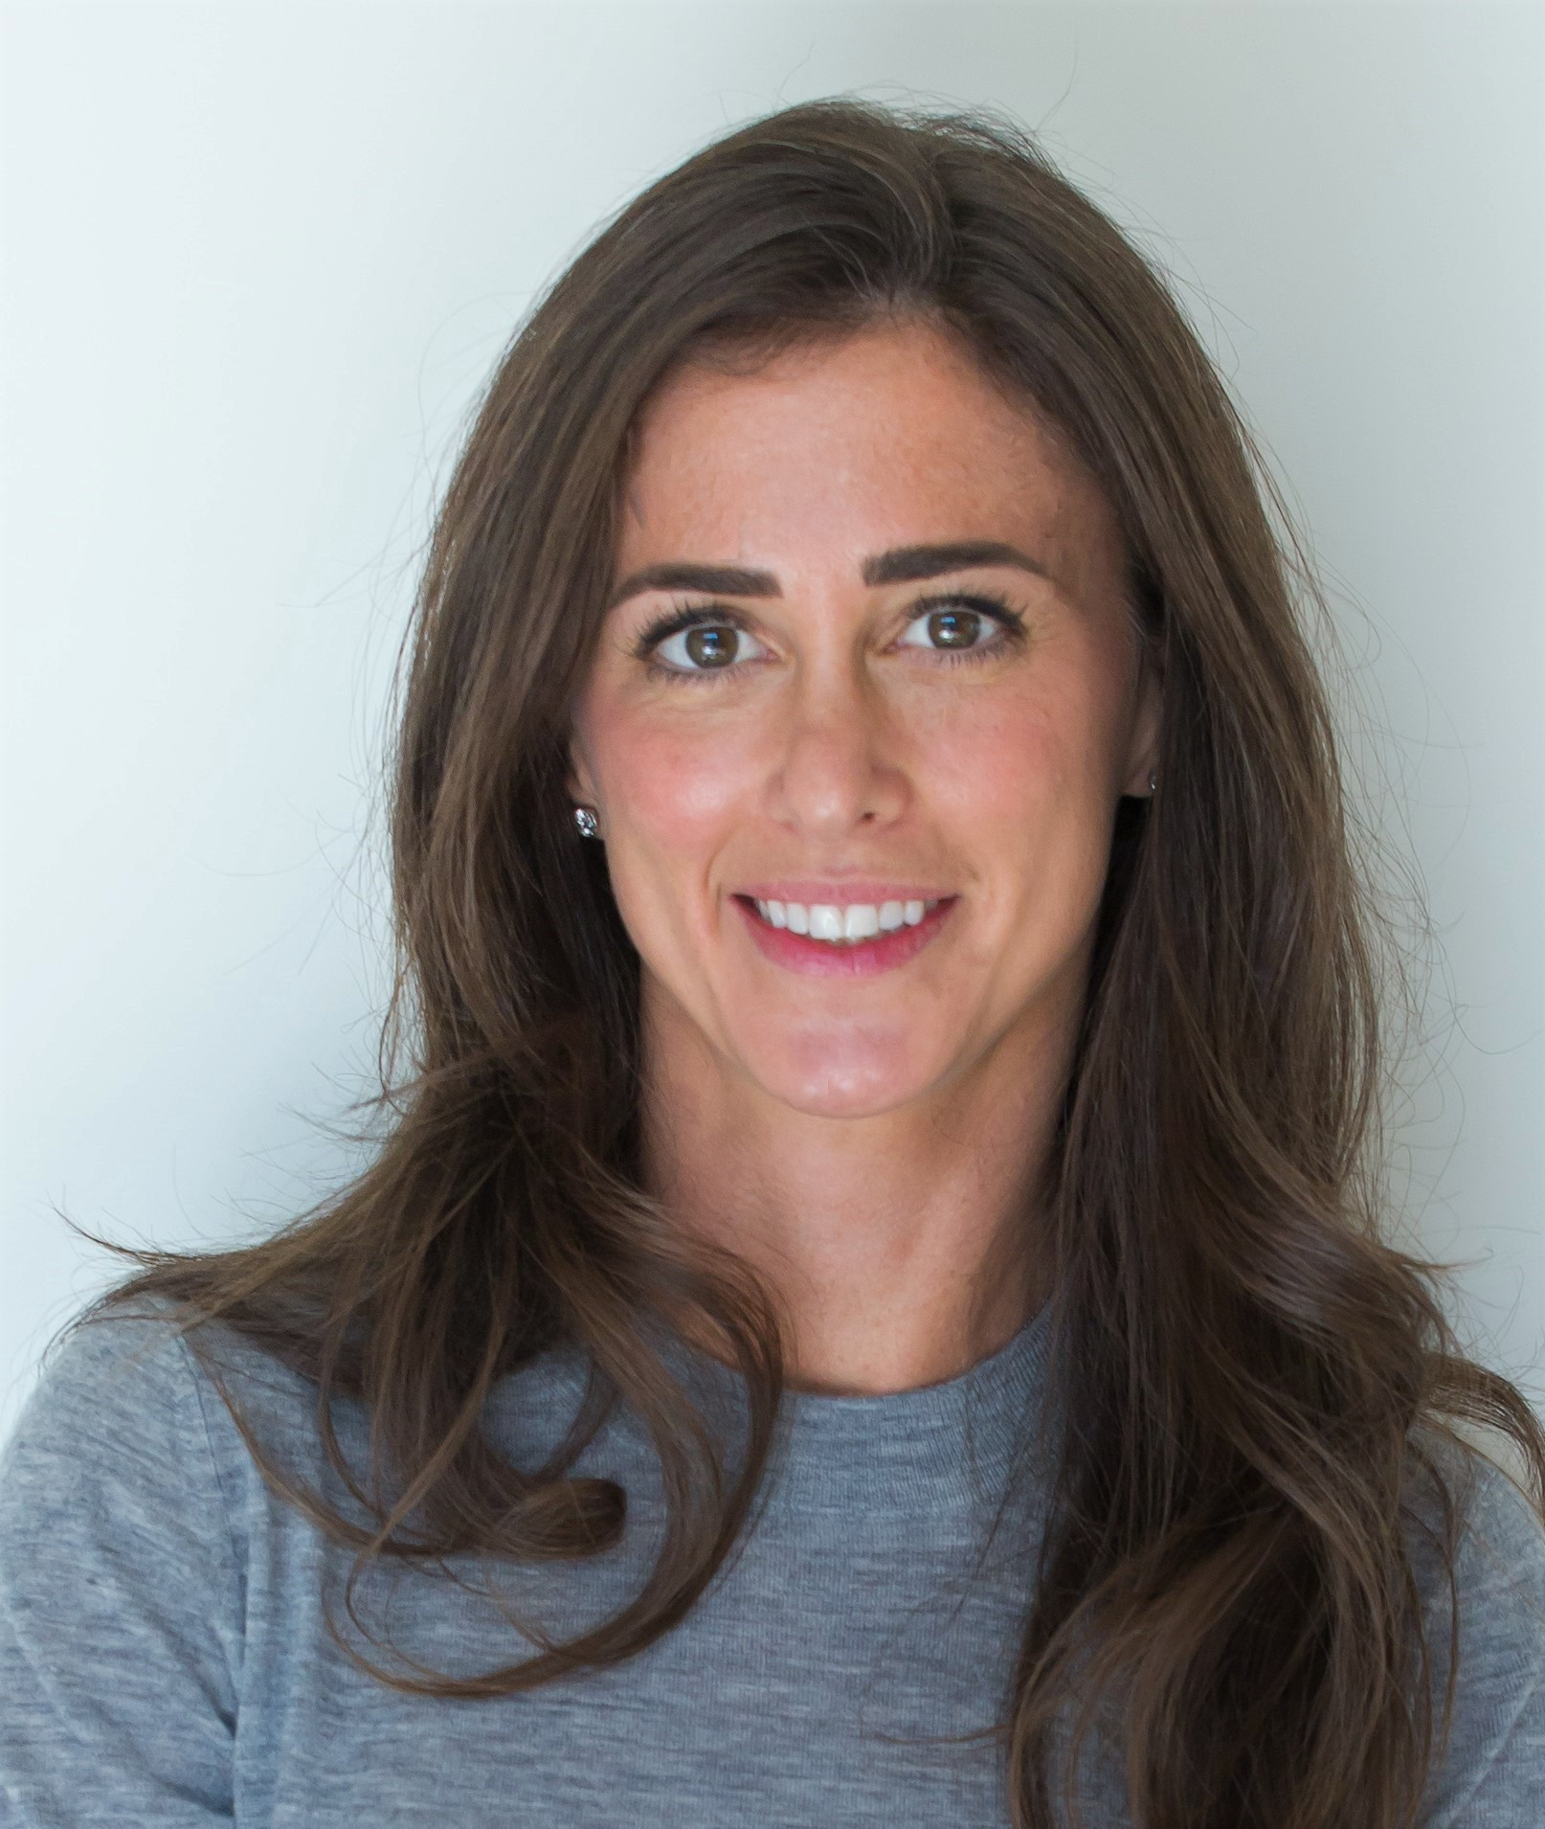
Noor Sweid
Global Ventures
Building a Venture Capital Firm
As a first-time female fund manager, Noor set out to build a VC firm investing in MENA startups
How do you build credibility from scratch while navigating gender bias and unfavorable LP mindset?
How do you get LPs in US and Europe interested in MENA startups?
Should she bring a male co-GP on board?
Research and data to build confidence in you and the fund
Focus on governance (what are the best practices and do better)
Harness FOMO when it’s in your favor.
Build Processes that outlast you

Slide 23
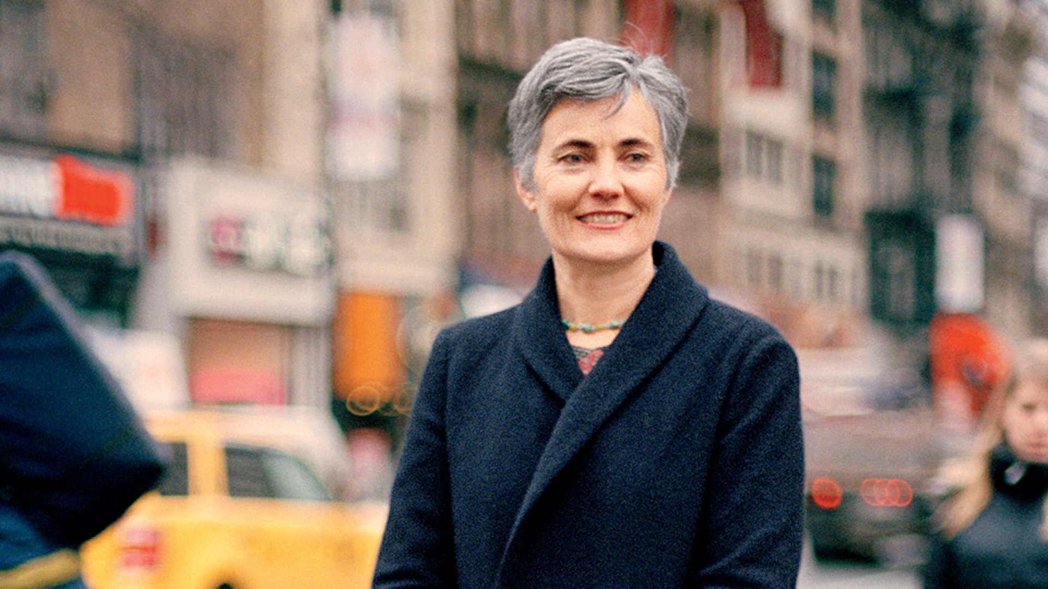
Robin Chase
Zipcar
Boards
Zipcar had a 5 member board (2 founders + 2 investors + 1 independent) and they asked Robin to fire her co-founder.
Despite strong growth, Robin was unable to raise a bridge round and add new board members. The board then fired her.
How could she have built a more supportive board?
Choosing investors aligned with your vision and goals
Success is not just about metrics - it’s also about mutual trust with employees, investors, partners, and customers
Trauma of being fired from “your” company is not easy to overcome

Slide 24
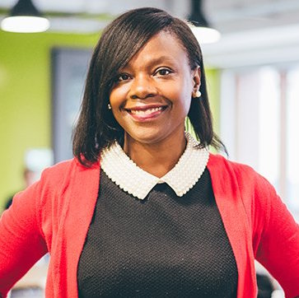
Donna Levin
care.com
Product Market Fit
An experienced, well-funded team launched care.com after careful market testing and validating assumptions. Yet, the launch was a disaster.
Then the finger pointing began and many in the C-Suite were at each other's throats.
How do you move forward?
There is no silver bullet - “test, test, test” and iterate
Securing early adopters is not the same as ascertaining Product/Market fit
How much someone is committed to the mission becomes clear only in moments of crisis.

Slide 25
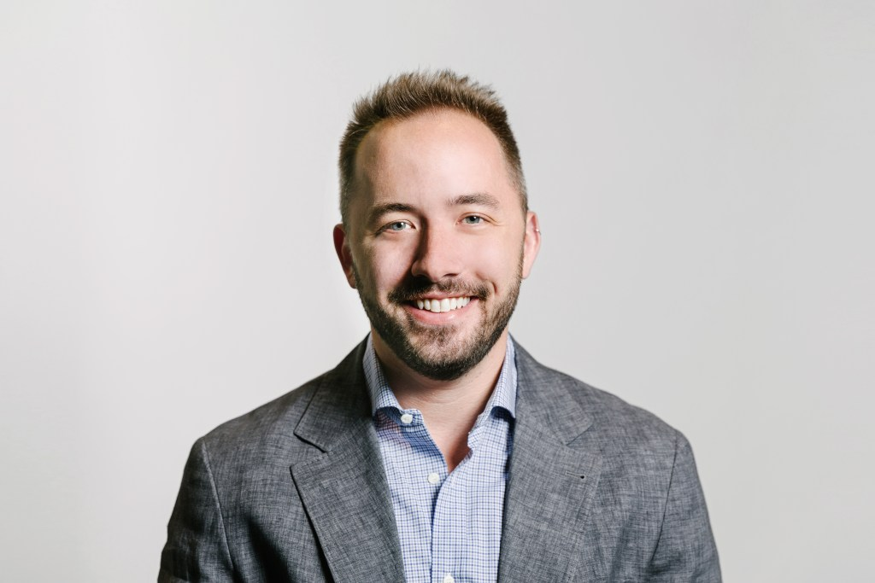
Drew Houston
Dropbox
Late Stage Go To Market
How do you stay viable in the face of crushing competition from Google/Apple/Microsoft when they give away your core product for free?
What aspects of Dropbox strategy should be ditched?
What is the playbook for dealing with competition from incumbents?
What business are we in, who are our customers, what job are they hiring us to do?
Disciplined M&A - focus on the core business
Growth mindset - personal growth vs company growth

Slide 26
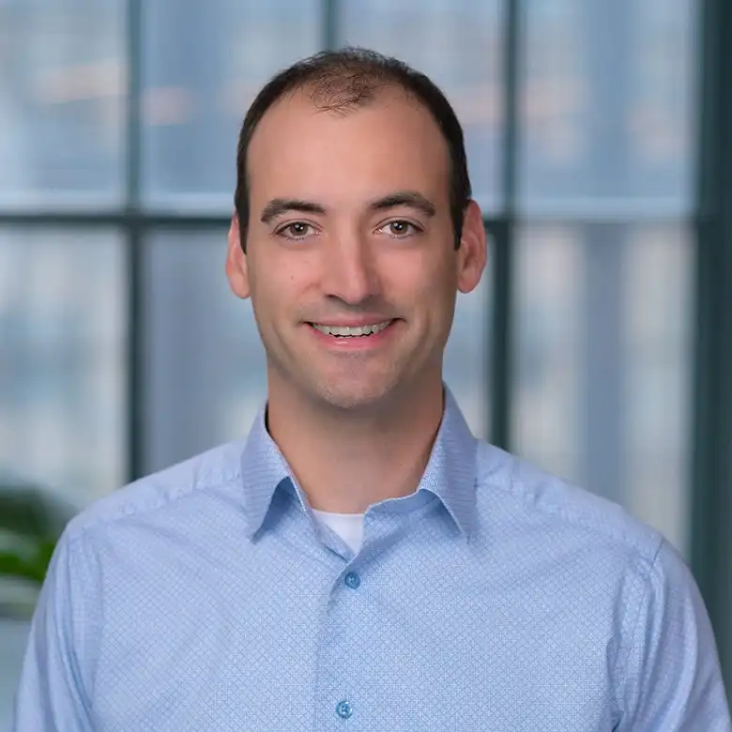
Steve Fredette
Toast
Dealing with a crisis
Toast had a strategic imperative to grow quickly and raised $765M in the 2 years before Covid-19 hit
Restaurant revenues dropped >75% and Toast was burning cash unsustainably
How should Toast navigate the crisis? What do you communicate to your customers, employees, board?
Don’t lose focus on customers - lending to keep them alive
Rapidly pivot to building new products (“takeouts”)
Culture, culture, culture

Slide 27
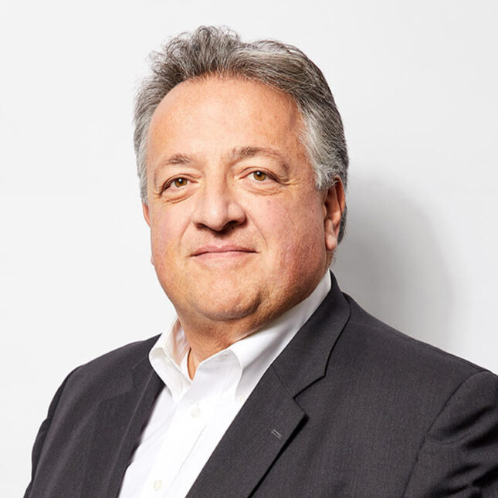
Noubar Afeyan
Moderna
Hypergrowth
Moderna was a 9 year old biotech company by early 2020. They had many mRNA vaccines including cancer vaccines in trials
As Covid’s global impact became clearer, what role should Moderna play? Should they find a Pfizer? Should Moderna participate in Operation Warp Speed?
How do you govern the company under extreme uncertainty, turbulence, and pandemic shutdown regime?
Uncertainty vs Risk
Collaborate with everyone who’s aligned with the mission without giving up control
Don’t sacrifice your principles for the sake of expediency

Slide 28
Emerging Market Dynamics: Access
Access to a Market
Is the local or regional market big enough ?
Is it mature enough ?
Access to Capital
Are there enough equity investors ? (Angels, VCs, PE etc)
Do they understand Venture capital or are they Vulture Capital ?
Do founders have the right expectations ?
Access to Talent
Can you find co-founders, CTOs, CHROs, CPOs etc ?
Can you find talented technologists, digital marketing experts etc ?
Can you find relevant advisors and board members ?
Access to Exits
How active is the M&A ecosystem in your country/region ?
What’s the mindset about selling ?
What other forms of exists are available ?

Slide 29
One Solution to Access: Global Startups
Products and services are developed and sold not locally but globally
Huge market
Can raise capital in the US or other favorable location
Can hire globally
Can exit globally
Challenges
Your product/service has to be competitive and differentiated globally
How do you sell in markets far from you ?
How do you recruit outside ur regions when no one knows you ?
How much more costs do you incure hiring, selling and setting up infrastucture globally ?
Does your team have a Global mindset ?

Slide 30
Another solution: UNIQUE Startups
Identify a Global niche and OWN it!!
India ?
Israel ?
Dubai ?
Create a supporting ecosystem that amplifies, sustains and locks in that niche
Universities, Investors, mentors, talent, incubators/venture studios, access to markets, bankers, legal framework etc
Invest in thought leadership & marketing for that niche
Social media, influencers
Conferences

Slide 31
Other Solutions
Become an AI-First company
Dramatically reduces cost and time for development/GTM/Ops/Hiring
No constraints on access to specialized knowledge
Ride the AI momentum
Leverage Diaspora in the US
Israel-American, TIE, OPEN, etc
Leverage Govt initiatives/funding/buying power etc
Tokenization
Allows access to global capital efficiently
Growth industry
Singles NOT Home runs
Serial entrepreneurs have LOTS more options and are FAR more successful

